Slide 1
Simulation of the
Slotted Aloha Protocol
Course Project
Esa Alghonaim
COE543 , 2003-2

Slide 2
Simulation flow.
Reference results (The analytical equations & curves).
Simulation Results & Graphs.
Conclusion

Slide 3
Simulation flow. (programmed using Delphi)
Start Simulation
Slot = 0 , Iteration = 0 , Tot_delay = 0 , Tot_attempts = 0 , Tot_succ = 0
Schedule time Arrival for each terminal
No
Iteration > Max_Iter
inc Iteration
Slot = Minimum arrival/retransmit time for terminals.
N = Number of terminals that has arrival/retransmit time = Slot
Yes
G = Tot_attempts / Slot
S = Tot_succ / Slot
Delay = Tot_Delay
Schedule new arrival time for the terminal
No
N > 1
Yes
Successful Slot
Collision Slot
inc Tot_attempts
inc Tot_succ
Tot_Delay = Tot_Delay +
(Slot-Arrival)
Schedule new arrival time for the terminal
Tot_attempts = Tot_attempts + N
Assign a random Backlog time for the N colliding packets.
If first collision for a packet, schedule new arrival time for the terminal.
Stop Simulation

Slide 4
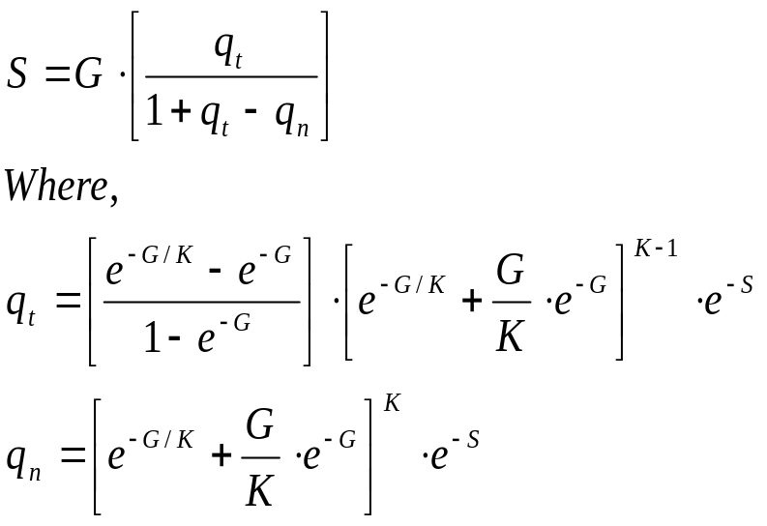

Analytical Results, S vs. G
Throughput
Offered Load
BackLog Constant
Probability of successful transmission / new packet
Probability of successful transmission / retransmitted packet
Average Number of retransmission cycles

Slide 5
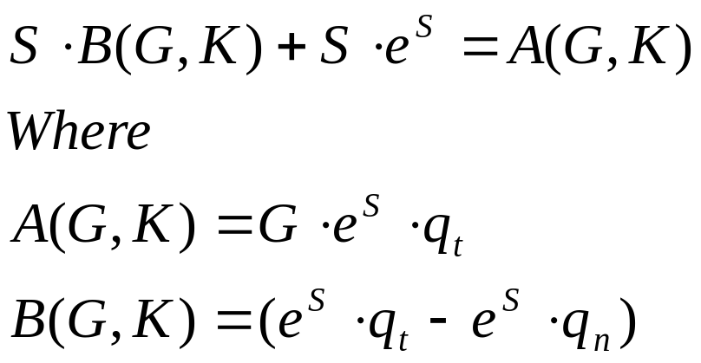
Analytical Results, S vs. G
Using the symbolic toolbox in the Matlab to generate
equations and solve them for different values of G & K.

Slide 6
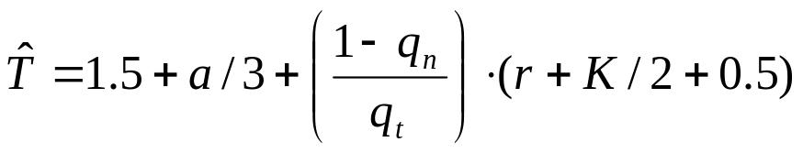
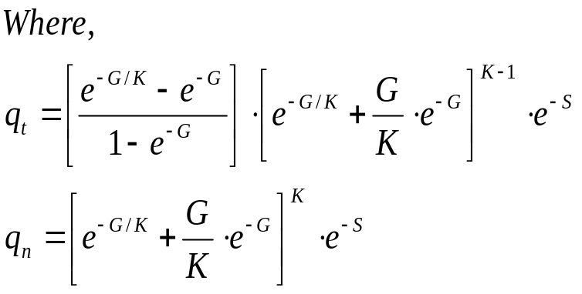
Analytical Results, Delay vs. S
a: normalized delay
r: collision detection slot

Slide 7
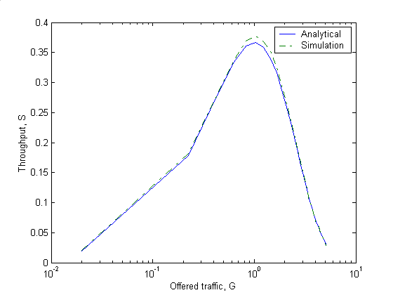
Simulation Results, S vs. G
Fig.1
Analytical and Simulation results
for Throughput (S) vs. Offered Traffic (G).

Slide 8
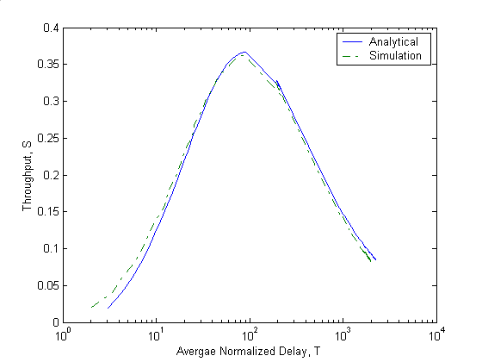
Simulation Results, Delay vs. S
Fig.2
Analytical and Simulation results for Delay vs. Offered Traffic.

Slide 9
Conclusion
Analytical and simulation results are very near to each other
Both analytical and simulation results indicate that there is an optimum point where the value of the throughput (S) becomes maximum, equal to 0.36
Increasing the offered traffic beyond this value, both Throughput and Delay becomes worse.

